Slide 1
Civil Procedure
Class 10

Slide 2
Agenda
Recap
Discovery!
Takeaways

Slide 3
I. Recap

Slide 4
Responsive Pleadings
8(b), in the Answer, a party must “admit or deny the allegations,” or deny because the party “lacks knowledge or information sufficient to form a belief”
12(b), party must assert “every defense to a claim” in “the responsive pleading”
But some defenses—like “failure to state a claim,” 12(b)(6)—can also be raised in a Rule 12 motion before filing the responsive pleading
So there is a choice between filing an Answer OR a pre-Answer Rule 12 motion
For most defenses, if not raised in either the responsive pleading or a Rule 12 motion, that defense may be lost—so plan ahead!

Slide 5
Amendment
15(a)(1), can amend a pleading “as a matter of course” within 21 days
15(a)(2), “in all other cases,” a pleading can be amended either with other party’s consent or “the court’s leave,” and court “should freely give leave” to amend “when justice so requires”
Court should give leave to amend freely, unless “undue delay,” “bad faith,” “futility of amendment,” “repeated failure” of prior amendments, or “undue prejudice” (Aquaslide)
Party opposing amendment must show prejudice (Aquaslide); prejudice means reduction in the party’s “ability to meet the defense on the merits” (Global Tech.)

Slide 6
II. Discovery Rules

Slide 7
Rule 26: The overall framework for discovery

Slide 8
Initial Disclosures
26(a), parties must make initial disclosures, including:
“each individual likely to have discoverable information” that the party “may use to support its claims or defenses,”
“documents, electronically stored information, and tangible things” the party “may use to support its claims or defenses,”
“computation” of damages and its “evidentiary” basis

Slide 9
Planning conference
26(f), parties must have a conference to plan discovery “as soon as practicable,” and at least 21 days before a “scheduling conference”
After conference, parties submit “discovery plan” proposing “the subjects” for discovery, “when discovery should be completed,” and whether it should be in phases
And proposing any other changes to discovery requirements

Slide 10
Scope of discovery
26(b) sets the overall scope and limits on discovery
26(b)(1), a party can discover:
  “any nonprivileged matter that is relevant to” any “claim or defense”
  “and proportional to the needs of the case”
  Factors for proportionality include: importance of the issue; amount in controversy; importance of the discovery to the issue; and whether the “burden” “outweighs” the “likely benefit”

Slide 11
Limits on discovery
26(b)(2), court can adjust limits on discovery in light of what’s necessary for the case, or what’s too burdensome/expensive
26(c), a party or any person from whom discovery is being sought can seek a protective order (if they certify that they tried in “good faith” to “resolve the dispute”)
Protective order can limit subject, time, place, method of discovery, or require some information to be sealed

Slide 12
Candor in discovery
26(e), if party learns it gave “incomplete or incorrect” information in discovery, “must supplement or correct” in “a timely manner”
26(g), when making a disclosure or a discovery request, certify “to the best of the person’s knowledge, information, and belief formed after a reasonable inquiry” that:
the disclosure is “complete and correct” and requests are “warranted” by law, not for improper purpose, not unduly burdensome
26(g)(3) provides sanctions for violating this

Slide 13
Key takeaways from Rule 26
Some required disclosures of the basis for your claims or defenses
Parties plan discovery, conferring with each other
The scope of discovery is: nonprivileged, relevant, and proportional information
The court can adjust the limits of discovery to fit the case
Parties can be sanctioned for improper actions in discovery

Slide 14
Types of discovery
I.e., how do you actually take discovery?

Slide 15
Depositions—Rule 30
witness testimony (can compel with subpoena)
after first 10, need leave of court for more
provide notice of deposition to other parties
a group entity, like a corporation or a government, can designate a deponent to “testify on its behalf”
can object to a question on the record; can seek order from court to limit or terminate if “conducted in bad faith”

Slide 16
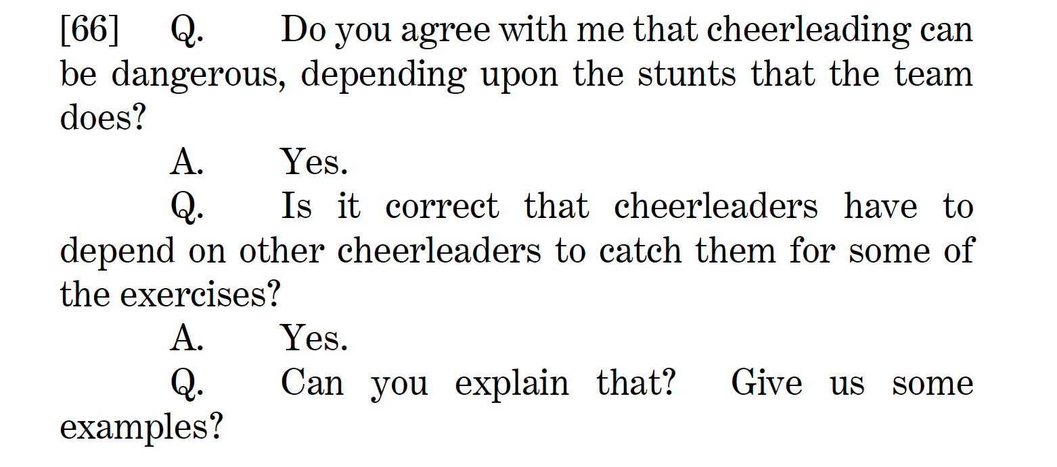
Sample Deposition from B.L. Case

Slide 17
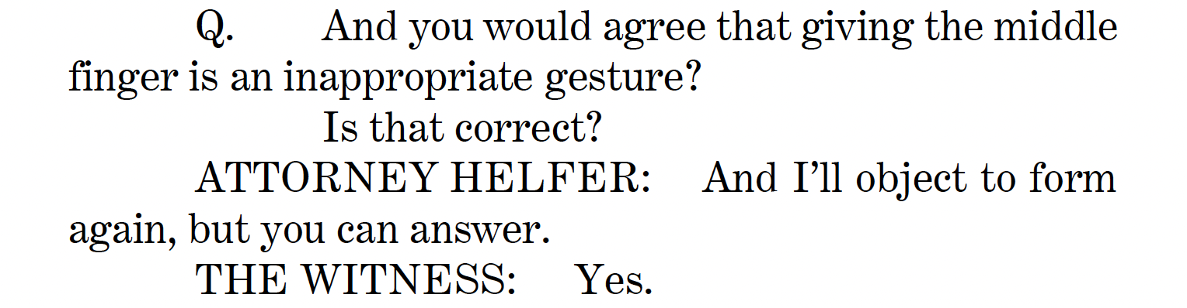
Sample Deposition from B.L. Case

Slide 18
Interrogatories—Rule 33
May serve on other party 25 written interrogatories (including “all discrete subparts”), asking about facts or legal contentions
Other party must answer, “fully” and “under oath,” within 30 days
Can object to an interrogatory, but must state objection “with specificity”
If the answer can be determined by examining business records, and the burden of examining is the same for both parties, the answering party can make the records available

Slide 19
Document Requests—Rule 34
Can serve on other party a request to produce and permit inspection and copying of:
  Documents
  ESI (electronically stored information)
  “tangible things”
  permit entry onto land to inspect
34(c) also allows subpoena for documents from nonparty

Slide 20
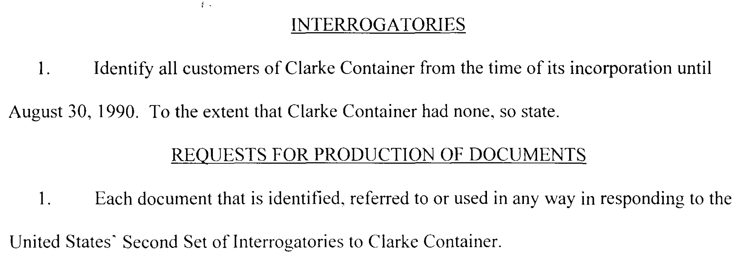
Sample Interrogatory and Document Request, from an Environmental Protection Case

Slide 21
Physical and Mental examination—Rule 35
If a party’s “mental or physical condition” “is in controversy,”
The other party may make a motion, showing “good cause,” and
The court may order “a physical or mental examination”

Slide 22
Requests for Admission—Rule 36
Can serve on other party “written request to admit, for purposes of the pending action only, the truth of any matters within the scope of” discovery
Related to “facts, the application of law to fact, or opinions about either,” or to confirm a document is “genuine”
An admission is “conclusively established” for the litigation
Not limited in number

Slide 23
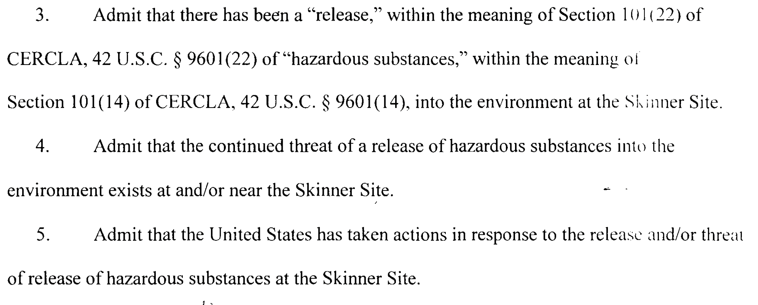
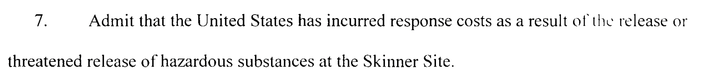
Sample Request for Admission, from an Environmental Protection Case

Slide 24
Summary: Types of Discovery
Depositions (Rule 30)
Interrogatories (Rule 33)
Documents, Electronically Stored Information, Tangible Things, and Property (Rule 34)
Mental and Physical Examination (Rule 35)
Requests for Admission (Rule 36)

Slide 25
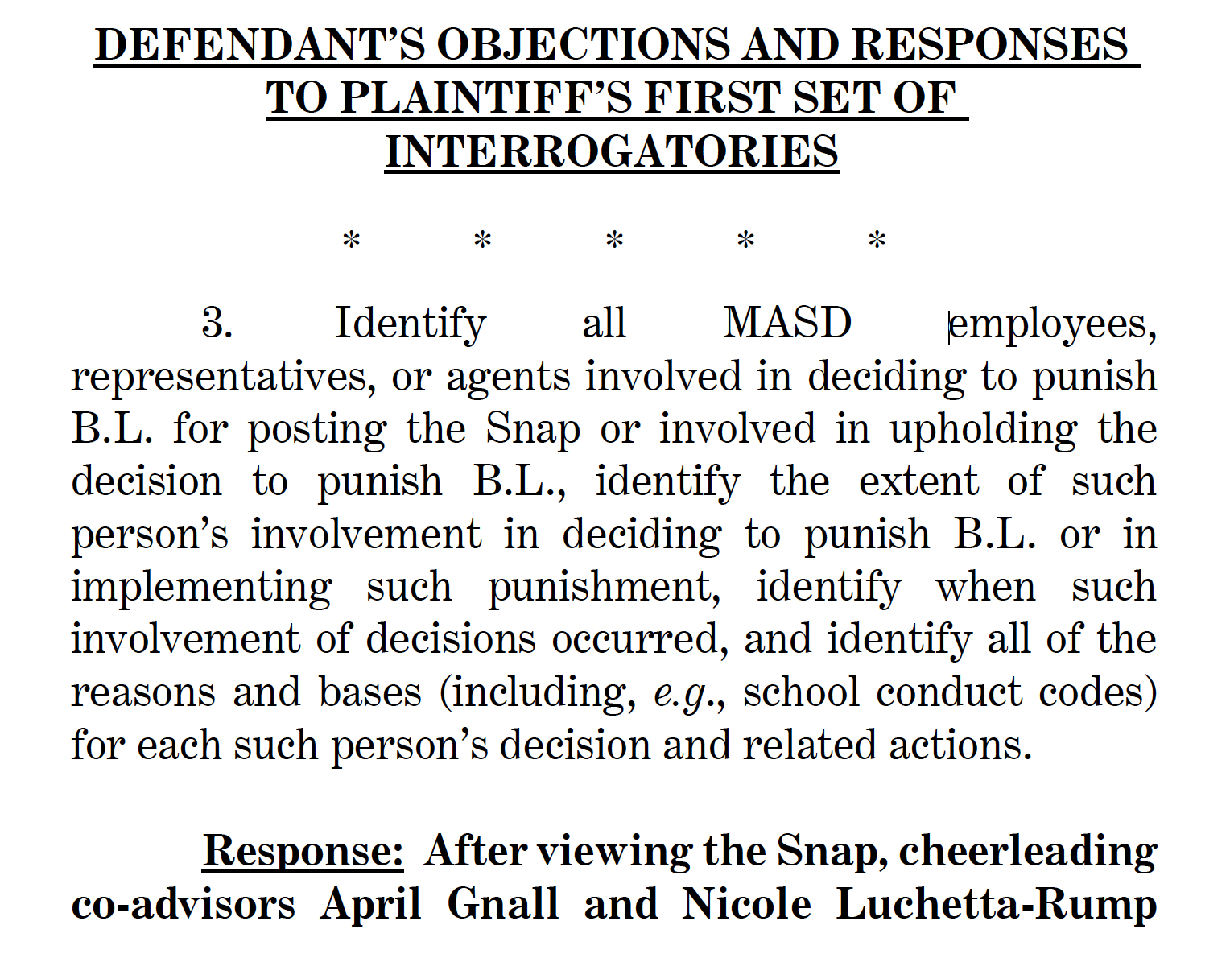
Sample Interrogatory from B.L. Case

Slide 26
Enforcing Discovery—Rule 37
37(a), for noncompliance with discovery, a party must first work “in good faith” with the other party or person to obtain discovery
If that fails, may seek order from the court to compel discovery
37(b), if someone fails to comply with an order compelling discovery, the court may sanction

Slide 27
Spoliation
Duty to preserve information that you knew or should have known would be relevant to anticipated litigation
Can be sanctioned for spoliation if the other party is prejudiced

Slide 28
III. Overall Takeaways

Slide 29
Key takeaways from Rule 26
Some required disclosures of the basis for your claims or defenses
Parties plan discovery, conferring with each other
The scope of discovery is: nonprivileged, relevant, and proportional information
The court can adjust the limits of discovery to fit the case
Parties can be sanctioned for improper actions in discovery

Slide 30
Types of Discovery
Depositions (Rule 30)
Interrogatories (Rule 33)
Documents, Electronically Stored Information, Tangible Things, and Property (Rule 34)
Mental and Physical Examination (Rule 35)
Requests for Admission (Rule 36)

Slide 31
Enforcing Discovery
37(a), for noncompliance with discovery, a party must first work “in good faith” with the other party or person to obtain discovery
If that fails, may seek order from the court to compel discovery
37(b), if someone fails to comply with an order compelling discovery, the court may sanction
General duty to avoid “spoliation”

